Slide 1






HOME CREDIT
SCORECARD MODEL
Shinta Amalia Paradita

Slide 2


01.
Improving the accuracy of credit score predictions using Machine Learning models so that lending decisions are more accurate and the risk of bad debt can be minimized.
PROBLEM RESEARCH
02.
Identify customers who are truly capable of repaying loans on time so that loan schemes can be adjusted to support successful repayment.
02

Slide 3

PROBLEM RESEARCH
01.
02.
03.
GOALS
OBJECTIVE
METRICS
Manage credit risk by reducing potential financial losses by selecting applicants who are capable of repaying loans on time.
Optimizing credit risk prediction models to improve accuracy in assessing loan applicant eligibility.
Developing machine learning models that can predict credit risk with high precision and identify applicants at risk of default.
Identifying factors that contribute to credit risk to provide a clearer picture of the factors that increase the likelihood of default.
Accuracy
F1-Score
ROC-AUC
Precision
Recall
MCC
03

Slide 4



DATASET
application_train
Contains complete customer data with targets (e.g., whether loans are repaid on time or not). This dataset is used to train Machine Learning models, including preprocessing, feature engineering, and model evaluation.
application_test
Contains customer data without targets. This dataset is used to generate credit score predictions for new customers or to test model performance on previously unseen data.
04

Slide 5



WORKFLOW
Loading the dataset, checking the structure and data types, and analyzing the initial statistical summary to understand the characteristics of the data.
Data Understanding
Visualize data, see distributions and relationships between variables, and explore relevant business patterns or insights.
METODE SATU
EDA
Handle missing values and duplicates, and perform data transformations such as normalization or encoding to prepare it for use in the modeling stage.
Data Cleaning
Selecting the most influential features, training the machine learning model with the cleaned data, and evaluating the model's performance to obtain the best prediction results.
Model Building
05

Slide 6
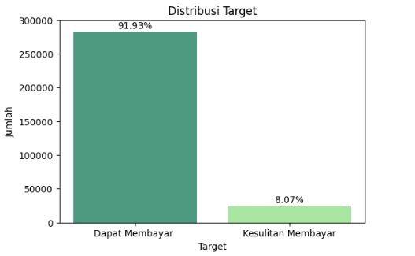
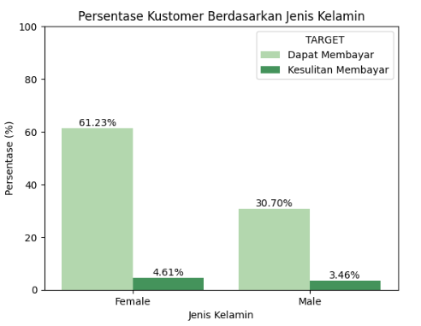
BUSINESS INSIGHT
A total of 8.07% of clients had difficulty repaying their loans, while 91.93% of customers were able to repay their loans smoothly. Although the proportion of defaults is relatively small, this is still important to note as it can affect business risk.
METODE SATU
The client base is dominated by women (61.23%), but they also contribute to a higher proportion of defaults (4.61%) compared to men (3.46%). This shows that although women dominate the number of customers, the risk of default in this group is slightly higher.
06

Slide 7
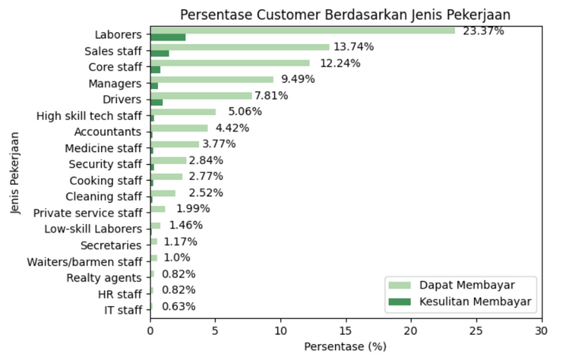
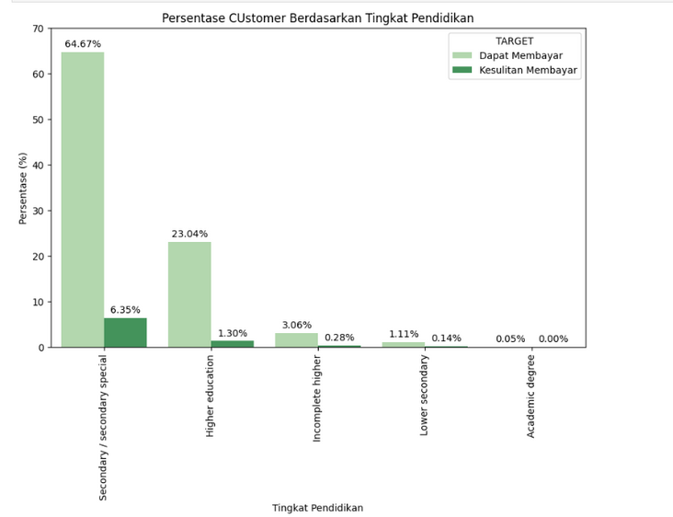
BUSINESS INSIGHT
The majority of clients come from the Laborers group (23.37%), followed by Sales staff (13.74%) and Core staff (12.24%). Although Laborers dominate the number of customers who are able to repay their loans, this group also has a large proportion who have difficulty repaying. Meanwhile, Managers (9.49%) and Drivers (7.81%) also contribute a significant proportion with relatively more stable payment distributions.
METODE SATU
Most clients come from secondary/secondary special education (64.67%), which also recorded the highest proportion of repayment difficulties (6.35%). Meanwhile, the higher education group ranked second (23.04%) with a lower level of payment difficulties (1.30%).
07

Slide 8

MODEL BUILDING
ML MODEL | ACCURACY | F1-SCORE | PRECISION | RECALL | ROC-AUC | MCC
LOGISTIC REGRESSION | 0.608 | 0.700 | 0.880 | 0.610 | 0.645 | 0.118
K-NEIGHBORS CLASSIFIER | 0.701 | 0.770 | 0.860 | 0.70 | 0.551 | 0.040
RANDOM FOREST | 0.909 | 0.880 | 0.860 | 0.910 | 0.605 | 0.034
DECISION TREE | 0.814 | 0.830 | 0.860 | 0.810 | 0.516 | 0.026
Based on the evaluation results, the Random Forest model showed the best performance compared to other models. This proves that Random Forest is most effective in identifying customers who are able to make repayments and predicting potential credit problems, thereby supporting improved accuracy in assessing borrower eligibility.
08

Slide 9


Bussiness Recommandation
01.
Improving Credit Assessment Quality
02.
Regular Monitoring and Validation
Use the model's predictions to refine the credit scoring process, enabling more targeted lending decisions. The model can also help distinguish between high- and low-risk customers more accurately, ultimately improving the quality of the company's credit portfolio and supporting sustainable business growth.
Monitor the model's performance regularly to ensure the consistency of prediction results. If there are changes in customer behavior or market trends, perform retraining to keep the model relevant. This approach ensures that the company's risk management strategy remains adaptive and effective in supporting long-term business objectives.
03.
Strategies Based on Occupation and Education
Customer groups such as laborers and sales staff, as well as customers with a secondary education, have a higher proportion of defaults. Companies can adjust limits and interest rates and provide financial education programs for these at-risk groups, while customers with more stable occupations or education receive more flexible credit facilities.
09

Slide 10




Terima Kasih

